Slide 1
How to manage off campus devices with Intune in our COVID world
Eric Orman - ericor@microsoft.com
Book online meeting with me = https://aka.ms/ericorman

Slide 2
Typical COVID scenario
Device is domain joined
No VPN
Users are low rights users without Admin access to devices
Managed using ConfigMgr (aka SCCM), WSUS, or some other on-prem solution or no management at all just GPO
Possibly a Remote Assistance capability while device is off campus
IT is concerned about lack of security updates, anti-virus, monitoring, KMS activations expiring, etc
HelpDesk receiving many calls to perform Admin actions
Goal: Regain and maintain management of devices while device is off campus ensuring the device works as if on campus

Slide 3
Scenarios
Goal: Regain and maintain management of devices while device is off campus ensuring the device works as if on campus
We have ConfigMgr (SCCM) and we like it
We have ConfigMgr (SCCM) and its all we got
We have ConfigMgr (SCCM) and we don’t like it
We don’t have any solution, just GPO
We also want to manage Apple devices and Android
Terminology overview

Slide 4
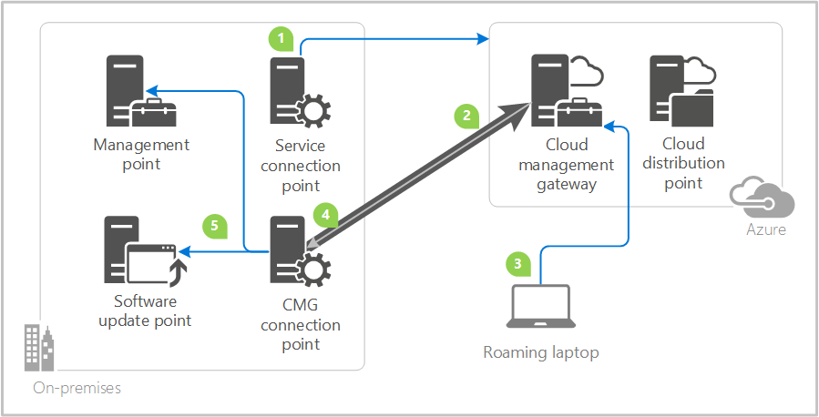
Co-mgmt vs CMG (Cloud Management Gateway)
Top questions;
“should I deploy CMG or co-mgt?”
“what are the differences between CMG and co-mgmt?”
Deploy CMG if:
ConfigMgr is working for you, it will extend all your operations to devices anywhere they are at
~$250 monthly is acceptable cost of CMG
Don’t deploy CMG if;
You are going to migrate fully to Intune

Slide 5
“Should we deploy ConfigMgr?”
Server management
PXE for imaging
Custom inventory
Data residency and data sovereignty
Connectors/Integrations

Slide 6
Cloud Management Gateway (CMG)
Pre-reqs:
Ensure SCCM is running 2006+ = Current branch versions - Configuration Manager | Microsoft Docs
Get Azure subscription, note: Person deploying CMG needs admin access to the Azure subscription
Enable Hybrid Azure AD join, follow this guide = Configure hybrid Azure Active Directory join for managed domains | Microsoft Docs
Acquire server certificate, this is used to secure the communications between on-prem SCCM and CMG that is running in Azure. Encourage to get 3rd party cert. GoDaddy is supported, here is guide for Digicert (I could not find a GoDaddy guide) = How to request a cert from public provider for Cloud management gateway – All about Microsoft Endpoint Manager (eskonr.com)
Verify Azure subscription has the following “Resource providers” set to registered, if not you’ll get these errors = https://msendpointmgr.com/2019/12/28/cloud-management-gateway-deployment-failed-due-to-missing-resource-provider-in-azure-subscription/
Verity the subscription has Microsoft.ClassicCompute set to registered
Verity the subscription has Microsoft.ClassicStorage set to registered
Verity the subscription has Microsoft.Storage set to registered
No client configurations are needed, clients when they check-in will get CMG policy and start communicating when they are outside of campus, no direct client configurations are needed.
Ensure your SCCM server has internet access, if you know that any ports, IP’s, URL’s are blocked, then review the required networking requirements = Data flow for cloud management gateway - Configuration Manager | Microsoft Docs
Deployment guide:
This is my favorite deployment guide (minus it showing how to create a PKI certificate) = New SCCM CMG Setup Guide With Latest EHTTP Certificate #1 (anoopcnair.com)
Official deployment guide = Set up checklist for CMG - Configuration Manager | Microsoft Docs
Other guidance:
Only put content on CMG DP that’s needed, don’t put Software Updates content on CMG DP, clients will fallback to MU/WU
If device is already co-mgt or your have some way to invoke elevated setting, you can deploy registry setting to tell client to start using CMG = Configure clients for CMG - Configuration Manager | Microsoft Docs
Gotcha’s
Devices off campus won’t automatically use CMG, they must first check-in with SCCM to get the new policy that tells them about CMG.
Devices that are Azure AD joined will not need PKI cert if a 3rd party server cert is used, they will need PKI if a PKI server cert is used, that is why we recommend to use 3rd party cert.
Cost:
Estimate ~$250 per month on Azure bill per 6k devices that will use CMG
Pre-reqs:
Ensure SCCM is running 2006 = Current branch versions - Configuration Manager | Microsoft Docs
Get Azure subscription, note: Person deploying CMG needs admin access to the Azure subscription
Enable Hybrid Azure AD join, follow this guide = Configure hybrid Azure Active Directory join for managed domains | Microsoft Docs
Acquire server certificate, this is used to secure the communications between on-prem SCCM and CMG that is running in Azure. Encourage to get 3rd party cert. GoDaddy is supported, here is guide for Digicert (I could not find a GoDaddy guide) = How to request a cert from public provider for Cloud management gateway – All about Microsoft Endpoint Manager (eskonr.com)
Verify Azure subscription has the following “Resource providers” set to registered, if not you’ll get these errors = https://msendpointmgr.com/2019/12/28/cloud-management-gateway-deployment-failed-due-to-missing-resource-provider-in-azure-subscription/
Verity the subscription has Microsoft.ClassicCompute set to registered
Verity the subscription has Microsoft.ClassicStorage set to registered
Verity the subscription has Microsoft.Storage set to registered
No client configurations are needed, clients when they check-in will get CMG policy and start communicating when they are outside of campus, no direct client configurations are needed.
Ensure your SCCM server has internet access, if you know that any ports, IP’s, URL’s are blocked, then review the required networking requirements = Data flow for cloud management gateway - Configuration Manager | Microsoft Docs
Deployment guide:
This is my favorite deployment guide (minus it showing how to create a PKI certificate) = New SCCM CMG Setup Guide With Latest EHTTP Certificate #1 (anoopcnair.com)
Official deployment guide = Set up checklist for CMG - Configuration Manager | Microsoft Docs
Other guidance:
Only put content on CMG DGP that’s needed, don’t put Software Updates content on CMG DP, clients will fallback to MU/WU
Gotcha’s
Devices off campus won’t automatically use CMG, they must first check-in with SCCM to get the new policy that tells them about CMG.
Cost:
Estimate ~$250 per month on Azure bill per 6k devices that will use CMG

Slide 7
Tenant attach / Co-mgmt. scenarios
Unified view of all devices in MEM
Monitor CM agent
Autopilot
Remote actions
Sync ConfigMgr collections to AAD groups
Workloads; updates, etc
Device actions on ConfigMgr client
Helpdesk RBAC
Timeline, scripts,
Find my PC (coming)
Read
Read = Cloud Attach Your Future - Part II - "The Big 3" - Microsoft Tech Community

Slide 8
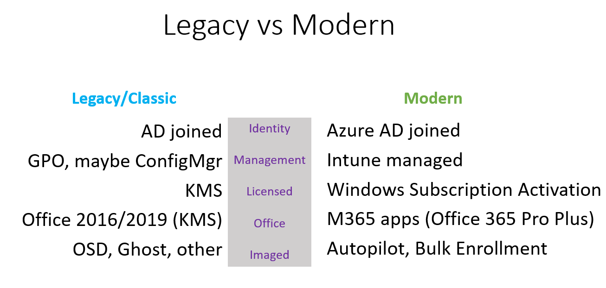
“What is a modern managed device?”
A device that is:
Azure domain joined (Identity ownership)
Intune managed (management)
activated via Windows Subscription Activation (Windows activation using M365 A3 license)
using M365 apps (aka Office 365 proplus)
Provisioned using Autopilot or Bulk enrollment (enrollment/imaging)
Data resides in SharePoint and OneDrive for Business (data)
Printing
files

Slide 9
Scenarios
Scenario | Scenario | Existing OS state | Enrollment Method | Domain Join type
1 | Existing AD joined devices | AD joined (HAADJ) | GPO enrollment | HAADJ
2 | New devices ordered from OEM/Partner | Vanilla image Pro/EDU or *Home | Autopilot or Bulk Enrollment | AADJ (or HAADJ)
3 | Devices that need to be reimaged, baremetal, etc | No OS | FFU+Bulk Enrollment or FFU+Autopilot existing device (offline profile) | AADJ
4 | Off campus devices | AD joined | *Autopilot or OOBE AADJ or VPN
*Home = needs to be reimaged with Pro/ENT/EDU
*Autopilot = if device is already Autopilot registered

Slide 10
Windows Enrollment methods
Method | Requires User license? | Enrollment type | Requirements | Comments | Azure join type options
GPO via HAADJ | Yes | Corporate | Devices are HAADJ Win10 v1709+ | Must enabled Hybrid Azure AD join in AD connector to sync on-prem domain joined devices to Azure | HAADJ
Co-mgmt. | No | Corporate | Devices are HAADJ Win10 v1709+ ConfigMgr 2002+ preferred | Requires Configuration Manager (aka SCCM) | HAAD & AADJ
Autopilot | Yes except SDM | Corporate | Win10 1803+ Device is Autopilot registered | Four flavors User Driven mode Self Deploying mode White Glove Existing Devices | HAADJ & AADJ
Bulk Enrollment (USB) | No | Corporate |  | Used during OOBE | AADJ
Add work and school account (BYOD) | Yes | Personal | User is local admin | Use with Conditional Access to force enrollment | AAD registered
Manual Azure AD join via Settings or commercial OOBE | Yes | Personal | User is local admin |  | AADJ
MDM only | Yes | Personal | User is local admin |  | AAD registered
Company Portal | Yes | Personal | User is local admin |  | AAD registered
https://docs.microsoft.com/en-us/mem/intune/enrollment/windows-enrollment-methods#:~:text=Intune%20enrollment%20methods%20for%20Windows%20devices%201%20User,Administrator-based%20enrollment%20in%20Intune.%20...%203%20Next%20steps

Slide 11
How to retire KMS
Retire KMS and migrate to using your M365 A3 license for activation services
Windows = “Windows Subscription Activation” for Windows activation
Office = M365 apps (Office 365)
Windows Subscription Activation
Requires devices to be either HAADJ or AADJ
Both activates and performs edition upgrade, uses embedded key
Just need to assign Win10 enterprise license to user
Tip - Ensure to use proper media to avoid activation failures
How to switch existing device activated via KMS to WSA using script
Requires embedded key in BIOS, if not then have to use KMS or MAK
Office (M365 apps)
Just need to assign M365 Apps that is included in M365 A3
User, SCA, or Devices based licensing activation for Windows, only User based for available for Mac

Slide 12
Hybrid Azure AD join
Benefits: both users and IT benefit from having devices that are HAADJ
Users:
SSO for end users for all Azure AD authentication prompts on Active Directory domain join PC’s
OneDrive auto login and Known Folder Redirection
Office 365 activation and auto signin when using M365 apps.
Store for Business
IT:
Reduce infrastructure
Remove Windows KMS, use Windows Subscription Activation, both edition and activation by assigning M365 A3 license
Remove Office KMS by moving to M365 apps.
Device based activation for M365 apps.
Management benefit
Intune enrollment via GPO, silent no end user interaction needed
CMG client certs
Auto login for OneDrive (and M365 apps)

Slide 13
Windows Enrollment workflow
There are four steps to Windows Enrollment:
Device connected to Azure
Device is connected either;
Azure AD registered
Azure Domain joined
Hybrid Azure domain joined
1
Automatic Enrollment
2
Azure AD setting
When enabled, will automatically enroll devices that get connected to Azure in step #1
3
Intune Licensing check
Does the user have Intune license assigned?
If yes, then proceed to Intune enrollment restrictions
If no, fail enrollment
4
Intune Enrollment Restrictions
Allow enrollment based on:
Device platform
Version
Personally owned
Model

Slide 14
Four flavors of Autopilot
Flavor | Supports Azure AD join | Supports On-prem domain join | Supports Bring your own VPN | Comments
User Driven Mode | Yes | Yes | Yes
Self deploying Mode | Yes | No | No | Requires TPM 2.0
WhiteGlove | Yes | Yes | n/a | Requires TPM 2.0
Existing devices | Yes | Yes | Yes | Include json file in build process Only UDM deployments, no Whiteglove

Slide 15
Identity ownership
Devices can be connected to Azure in three different ways;
Azure Domain Joined (AADJ) – directly domain joined to Azure
Hybrid Azure Domain Joined (HAADJ) – domain joined on-prem AD and sync’d to Azure, ownership remains on-prem
AD registered (WPJ) – SSO connection only
Pro/Con’s of AADJ vs HAADJ
How to enable HAADJ - https://docs.microsoft.com/en-us/azure/active-directory/devices/hybrid-azuread-join-federated-domains

Slide 17
USB method: FFU + Bulk enrollment
Using USB;
Add FFU image to install fresh image
Add Provisioning Package (ppkg) using Windows Configuration Designer to enroll into Intune.
USB can be dual purpose, it can both image device and or if device is at OOBE it will bulk enroll device into Intune using the provisioning package.
Watch video how to create provisioning package:
FFU file share = https://aka.ms/ffu and password = ffu!

Slide 18
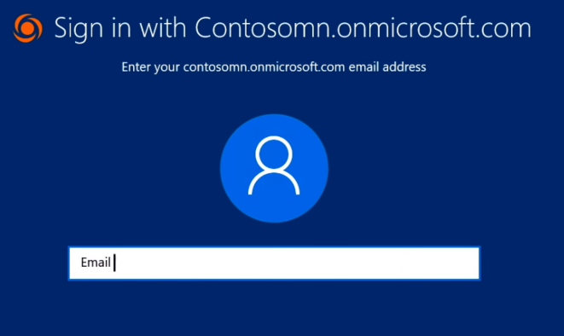
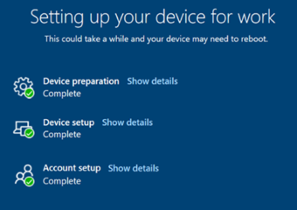
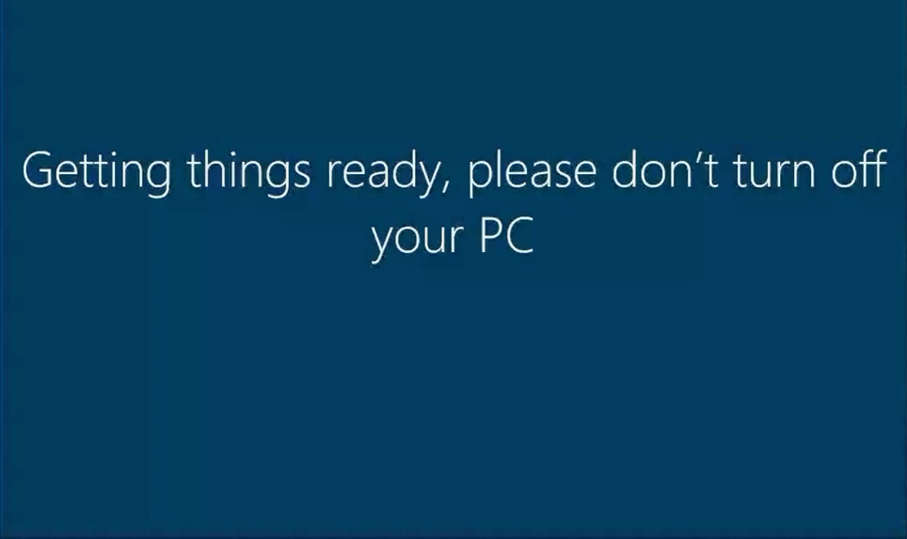
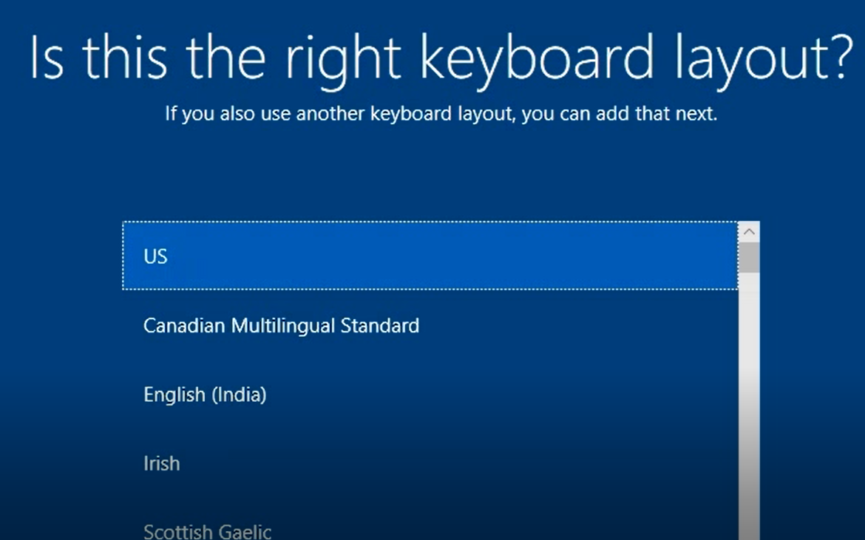
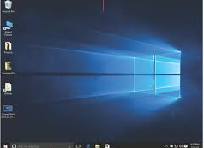
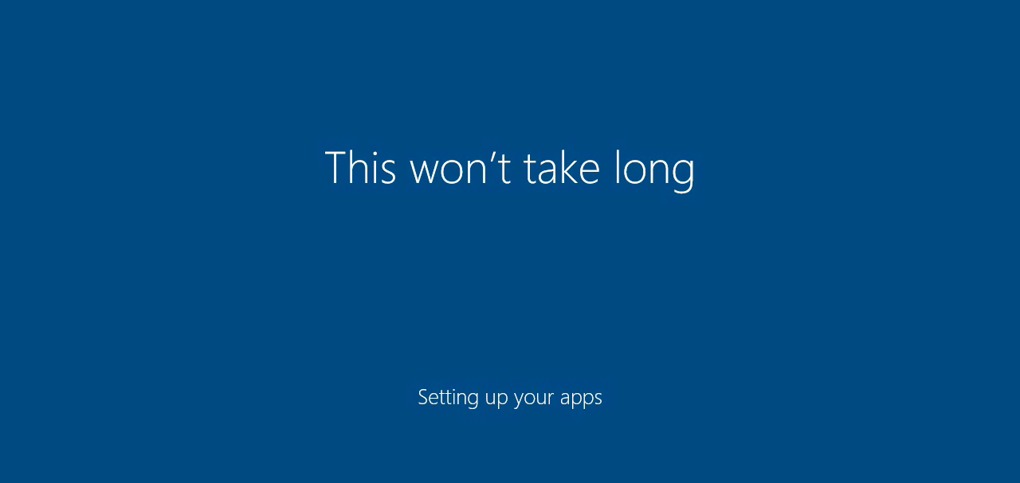
Autopilot workflow – User Driven Mode (UDM) with Enrollment Status Page (ESP)
Device registered in Autopilot by;
OEM/Partner
Powershell script
ConfigMgr (via .csv file)
Existing Intune managed
Intune
1
AAD
AP service creates AAD object for device
2
4
Intune sends User targeted apps and profiles
Azure AD join
8
6
Autopilot Service
(AP)
5
Intune sends device targeted apps and profiles
MDM enrolls
3
Autopilot profile download
FSIA, user profile login
7
Autopilot profile download
Boot
Device ESP
(OOBE)
AADJ &
Enrollment
User login
FSIA
User ESP
Desktop
Lang,Keyboard,Network
Timeline
1
2

Slide 19
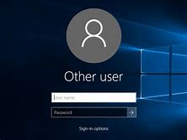
Autopilot workflow – Self Driven Mode (SDM) with Enrollment Status Page (ESP)
Device registered in Autopilot by;
OEM/Partner
Powershell script
SCCM
Existing Intune managed
Intune
1
AAD
AP service creates AAD object for device
5
2
MDM enrolls
TPM attestationn & Azure AD join
4
8
Intune sends User targeted apps and profiles
Autopilot Service
(AP)
Intune sends device targeted apps and profiles
6
3
Autopilot profile download
7
FSIA, user profile login
Autopilot profile download
Boot
Device ESP
(OOBE)
User login
TPM attestation,
AADJ & Enrollment
FSIA
User ESP
Desktop
Lang,Keyboard,Network
Timeline
2
Optional
1

Slide 20
Hybrid Azure AD Autopilot flow
AD
Intune gets Offline Domain Join (ODJ) blob from AD domain controller via the Intune Hybrid Connector
5
9
Device registered in Autopilot by;
OEM/Partner
Powershell script
SCCM
Existing Intune managed
HAADJ of device to AAD
Intune
1
AAD
10
Intune sends User targeted apps and profiles
2
Autopilot service creates AAD object for device
Client enrolls into MDM
Intune sends device targeted apps and profiles
* Policies targeted to AADJ record
4
7
Autopilot Service
(AP)
Client downloads ODJ blob and performs local domain join then reboots
Pause before User ESP begins to allow HAADJ to complete
*don’t touch either record
6
User logs into AD using AD creds
9
8
3
Autopilot profile download
Autopilot profile download
Boot
User login
#2
AADJ &
Enrollment
User login
#1
Device ESP
(OOBE)
User ESP
Desktop
FSIA
Lang,Keyboard,Network
Timeline
1
2
3

Slide 21
Compare of USD, SDM, WG
Autopilot profile download
Boot
Device ESP
(OOBE)
AADJ &
Enrollment
UDM
User login
FSIA
User ESP
Desktop
Lang,Keyboard,Network
Timeline
2
1
Autopilot profile json on device
Boot
Device ESP
(OOBE)
AADJ &
Enrollment
Existing
User login
FSIA
User ESP
Desktop
Lang,Keyboard,Network
Timeline
1
2
Autopilot profile download
Boot
Device ESP
(OOBE)
User login
SDM
TPM attestation,
AADJ & Enrollment
FSIA
User ESP
Desktop
Lang,Keyboard,Network
Timeline
2
Optional
1

Slide 22
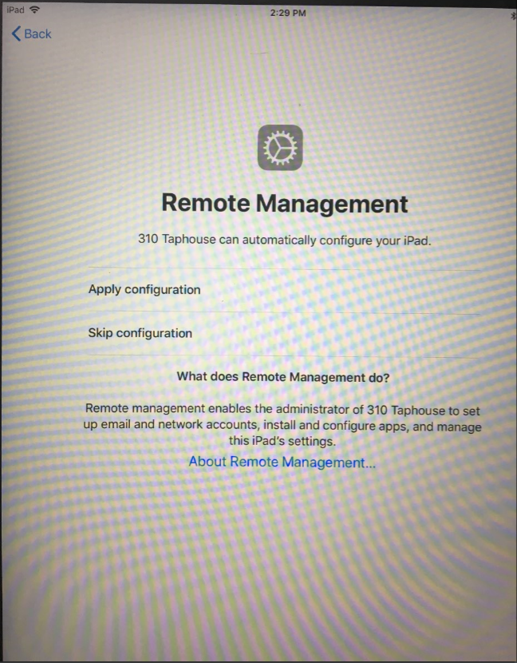
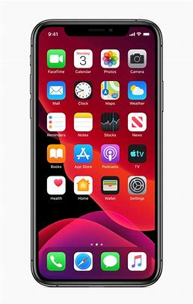
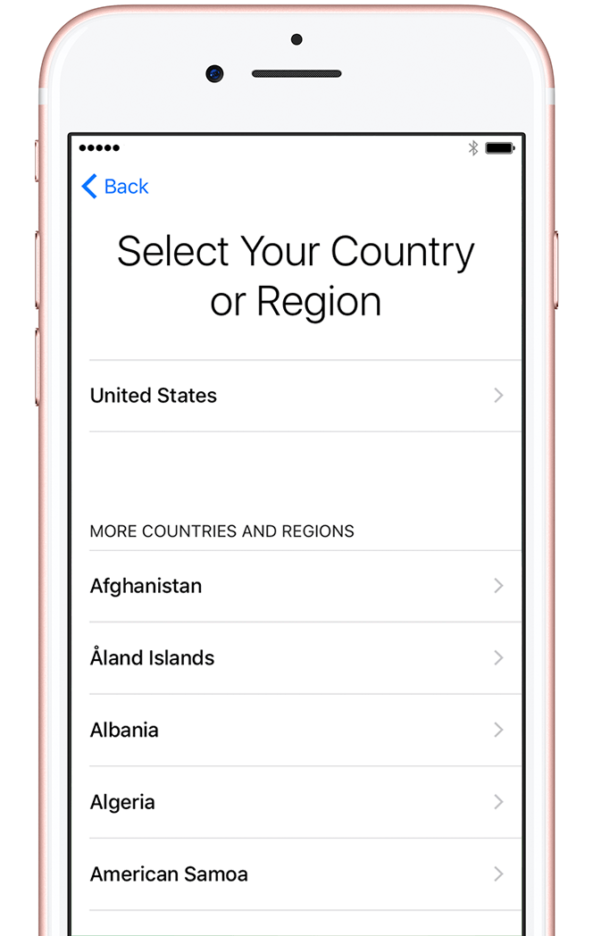
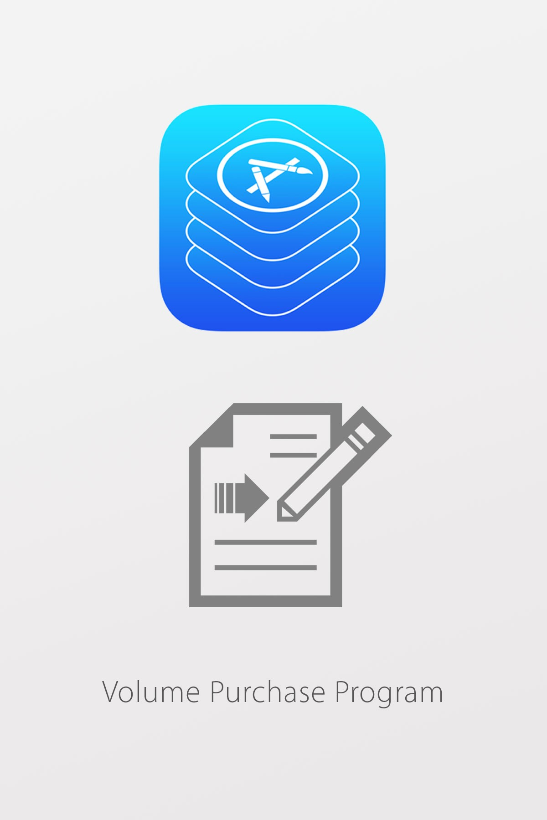
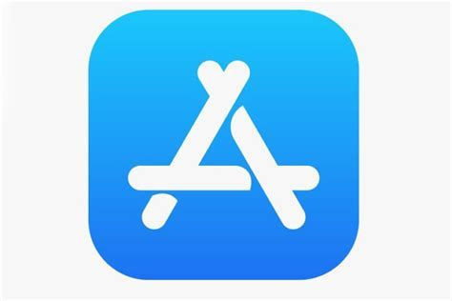
Apple School Manager (ASM) enrollment
Setup:
Configure APNS
Configure ASM Connector
In ASM, reassign devices to Intune MDM
Create and assign profile to Apple devices in Intune
Verify profile assignment before attempting enrollment
3
1,2,4
ASM/DEP
12h
Intune
Intune Connector to ASM/DEP
AAD
8
Apps installs
5
Azure AD register
iOS profile download
7
4
Done
6
MDM enrolls
With user affinity
With no user affinity
(no prompts for password)
App install
Profile download
Boot
1
Timeline
2
2
Done

Slide 23
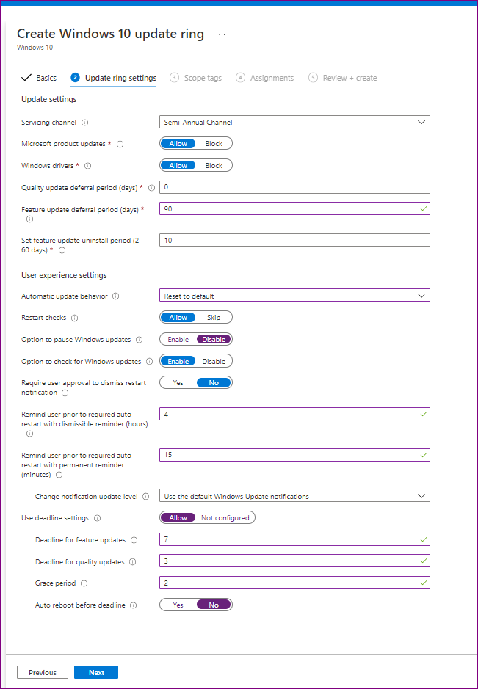
Windows Update for Business recommended settings
Common policy configuration mistakes for managing Windows updates - Microsoft Tech Community

Slide 24
Office - KMS vs Office 365 (M365 apps)
“Office 365 ProPlus” rebranded to “Microsoft 365 apps”
Installation & activation differences;
Office 2013/2016 two versions;
msi activated via KMS/MAK
click to run specific to O365 ProPlus
Office 2019/2021^{(coming fall 2021)}, unified on installation package via click to run
Activated via KMS or online via M365 apps license
Office 2019 can be converted to M365 app flavor using GPO
Three ways to activate M365 apps on Windows and one for Mac
User (5 installs on Mac or Windows managed by user in Office.com)
Shared Computer Activation (SCA) only Windows
Device based (DBS) only Windows
Intune has first class experience deploying M365 apps
M365 activation methods | Windows | Mac
User | Yes | Yes
Shared Computer Activation (SCA) | Yes | No
Device Based Subscription (DBS) | Yes | No

Slide 25
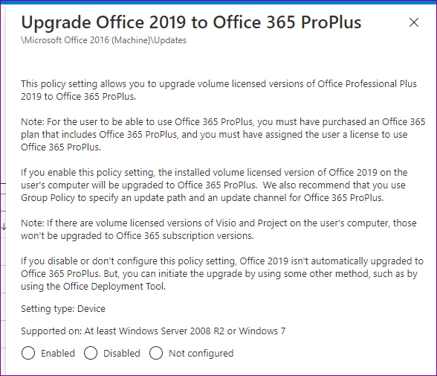
GPO to convert

Slide 26
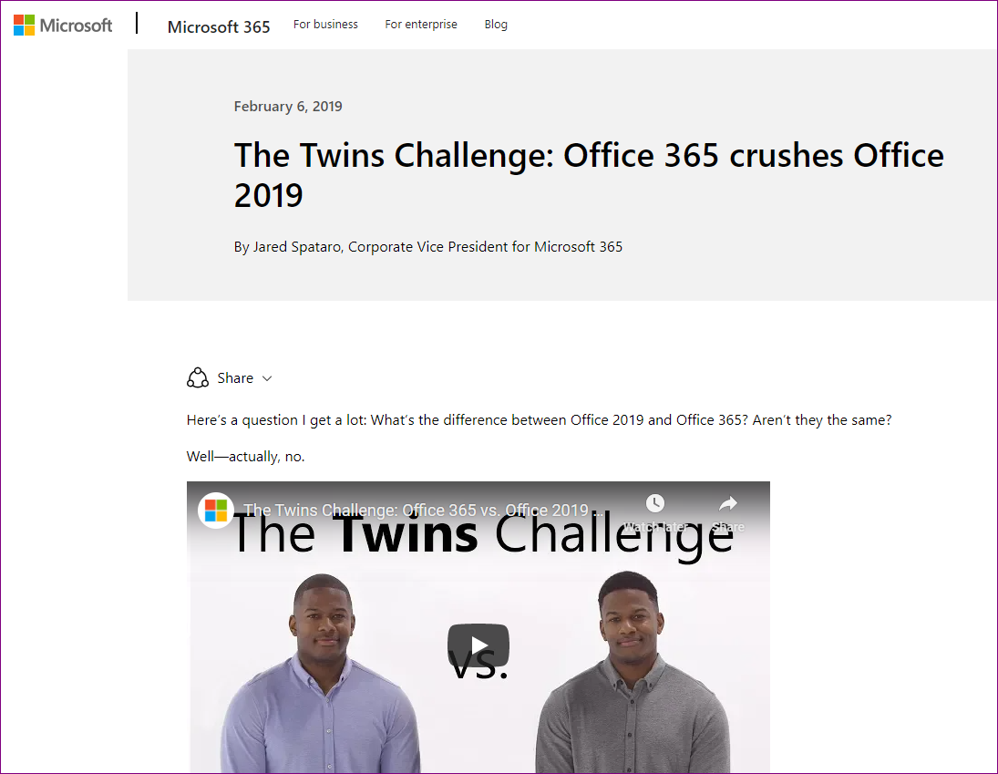
The Twins Challenge: Office 365 crushes Office 2019 - Microsoft 365 Blog

Slide 27
M365 apps deployment on MacOS
Deploying Microsoft 365 Apps for Mac with Microsoft Endpoint Manager - A Deep Dive - Microsoft Tech Community

Slide 28
Mac enrollment
Method | Requires license | Enrollment type | Caveats | Comments
Apple School Manager (ASM) | Depends | Corporate | Device must be factory reset | Requires devices to be in ASM, cannot add personal purchased devices (Best Buy) to ASM, only devices purchased direct from Apple or reseller.
Direct Enrollment | No | Corporate | Can be enrolled on existing device without factory reset
Personal enrollment via Company Portal app | Yes | Personal | Can be enrolled on existing device without factory reset
No concept of supervised devices for Mac like there is for iOS/iPad

Slide 29
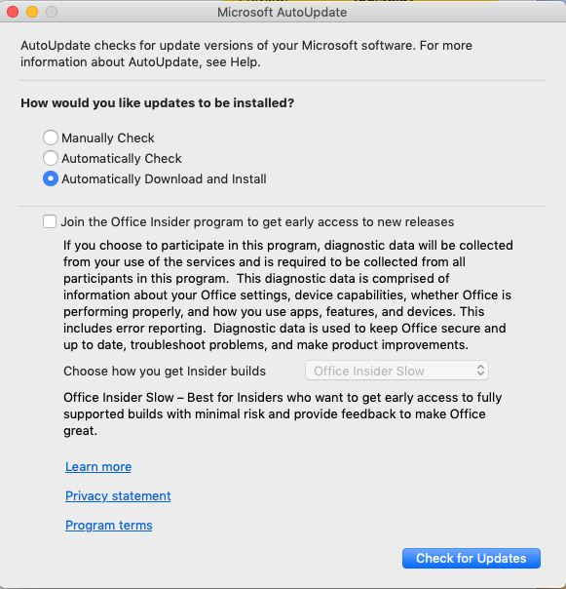
Mac OS updates
https://docs.microsoft.com/en-us/windows/security/threat-protection/microsoft-defender-atp/mac-updates
OS updates coming for Intune
Default MS AutoUpdate settings
Configure XML file
Ring
Auto Download
Etc

Slide 30
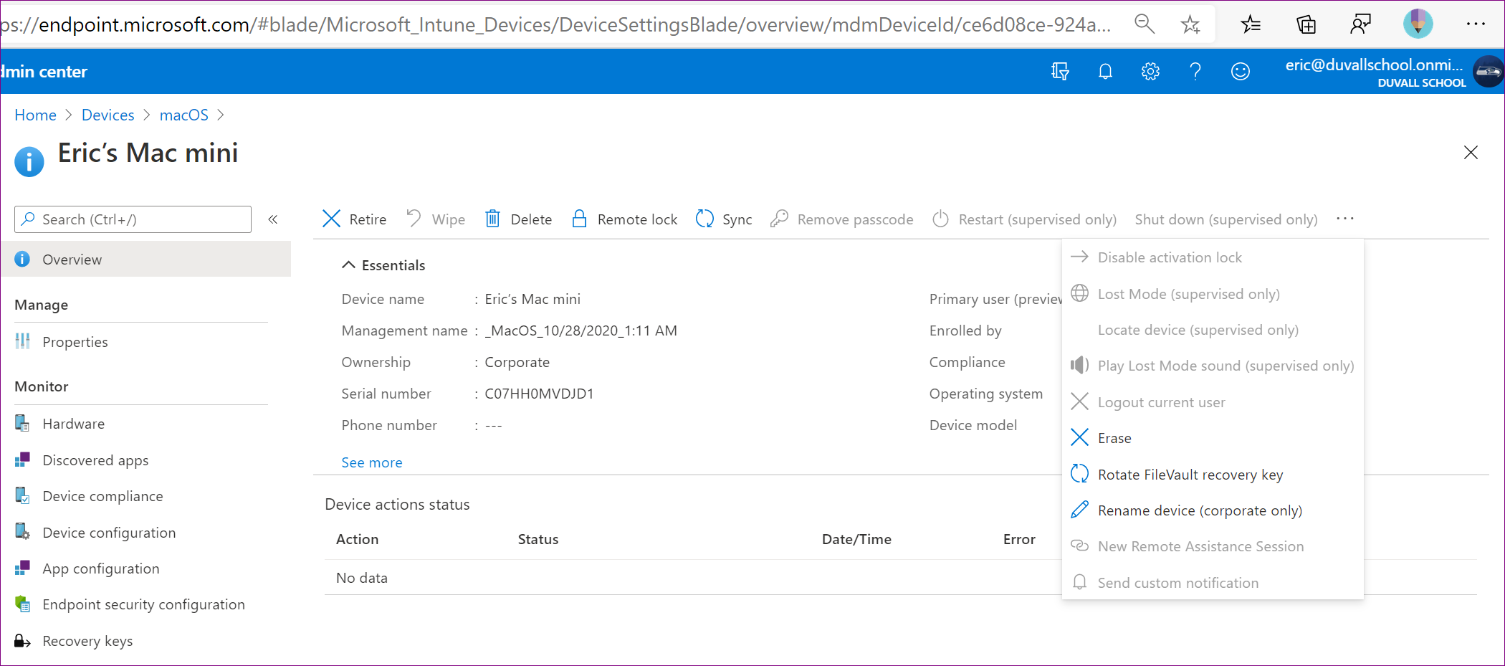
Mac remote actions
Corporate or Personal only, no Supervised mode like there is with iOS/iPad

