Slide 1
LMS + M365 using Learning Tools Integration
Micah Linehan – Principal Education Solution Architect, PPM LMS Integrations

Slide 2
Empowering a connected, experience platform.
Teaching and
Learning
Professional development
Faculty and staff coordination
Health and Life Sciences
Research
Student community building
Notes:
.

Slide 3
Better together: Providing educators a simplified way to do their valued jobs
Learning Management Systems
Best-in-class tools for videoconferencing and real-time collaboration
The critical foundation for classroom management

Slide 4
Brought together | Used together
Creating a simple, integrated learning experience platform
Learning Management Systems
Course management
Content design & setup
Calendar
Attendance
Assignments
Assessments
Gradebook
Outcomes
Parent engagement
Reporting
Analytics
Productivity apps
Chat
Real-time collaboration
Video classes
Breakout groups
Live engagement
Social expression
Secure cloud file storage
21st century skills training
Teaching and learning re-imagined​
Complimentary workspaces for teaching and learning
Seamlessly integrated
Improved learning environment

Slide 5
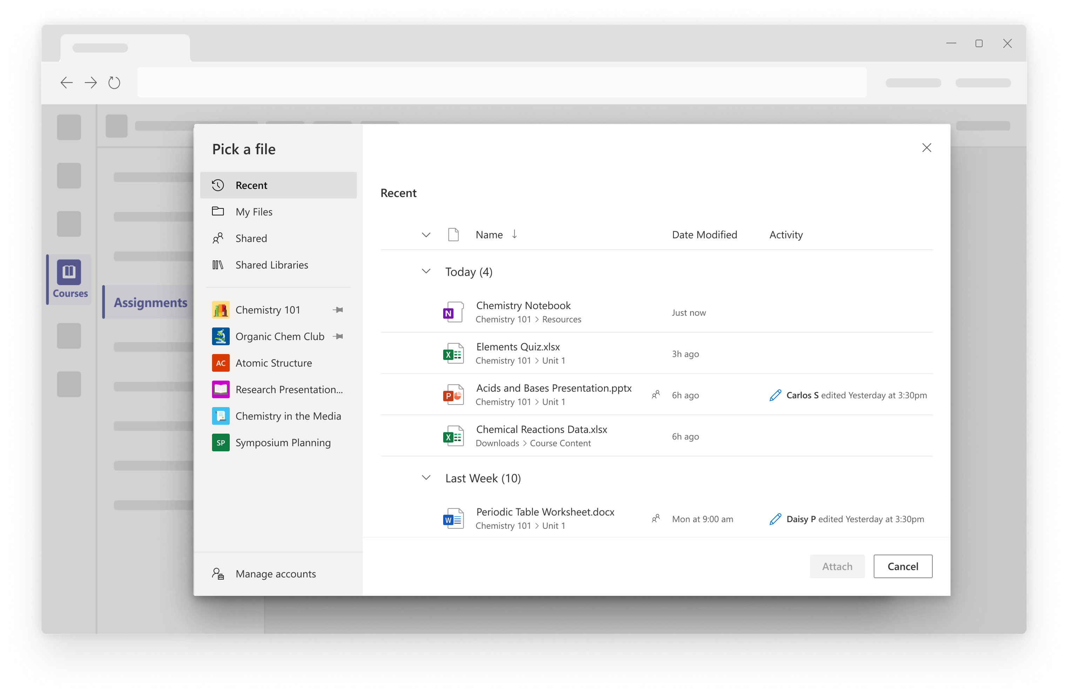
Find and embed Office docs with the new OneDrive LTI app
The OneDrive LTI app (LTI 1.3) allows educators and students to create course content, complete assignments and collaborate using OneDrive and Microsoft 365 all without leaving the LMS.
Integrates with assignment, collaboration, and grading workflows
Educators can add Microsoft files to course content and assignments
Students can work on Microsoft document assignments and collaborations
Support for multiple OneDrive accounts
Modern and updated user experience including new OneDrive picker and new Microsoft viewers and editors
Release timing: August 2021 (Canvas)
Microsoft Confidential

Slide 6
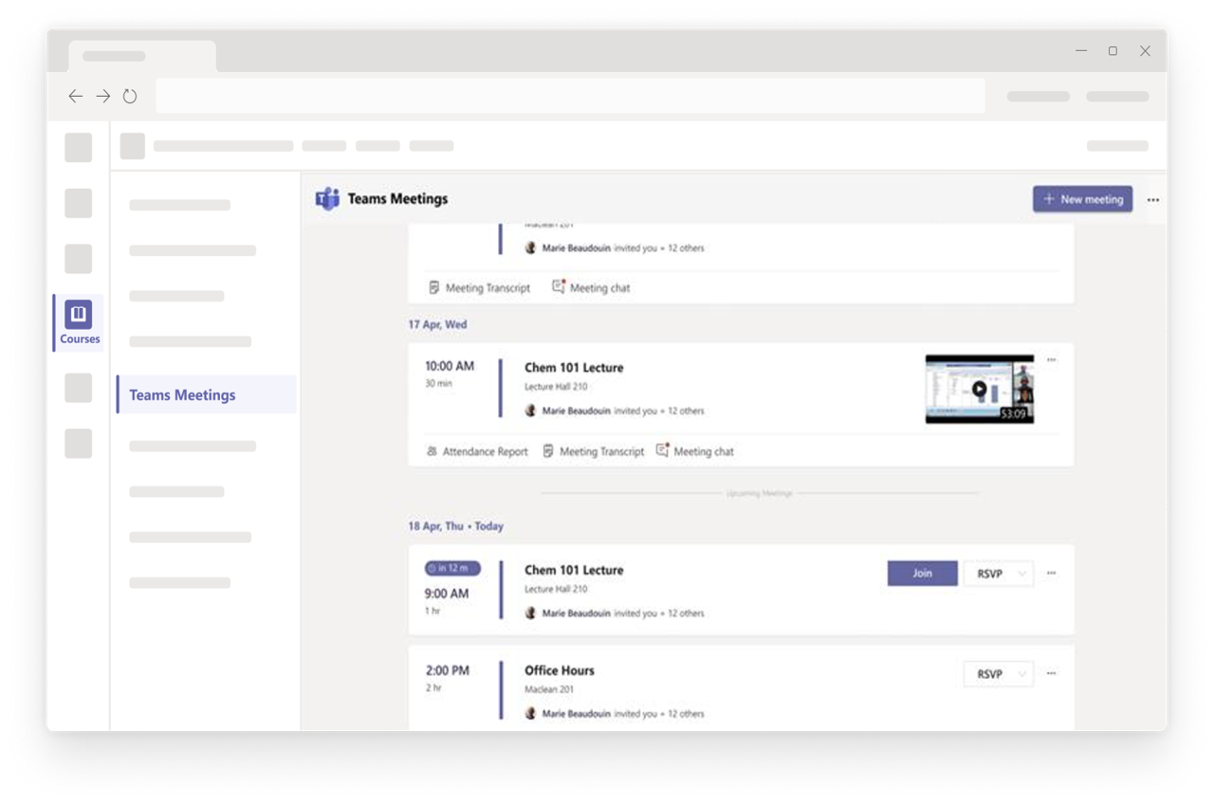
Access a meeting agenda view with the improved Teams Meetings LTI app
The improved Teams Meetings LTI app will help educators and students more easily integrate class meetings into their course work.
Schedule individual or recurring meetings within the course in the LMS and set meeting options (based on tenant policies)
Join or edit the details of a Teams meeting from the course in the LMS (deep link into Teams)
Access previous meeting artifacts within the LMS course, including chat, recordings, transcripts, and attendance reports
Release timing: August 2021 (Canvas)
Microsoft Confidential

Slide 7
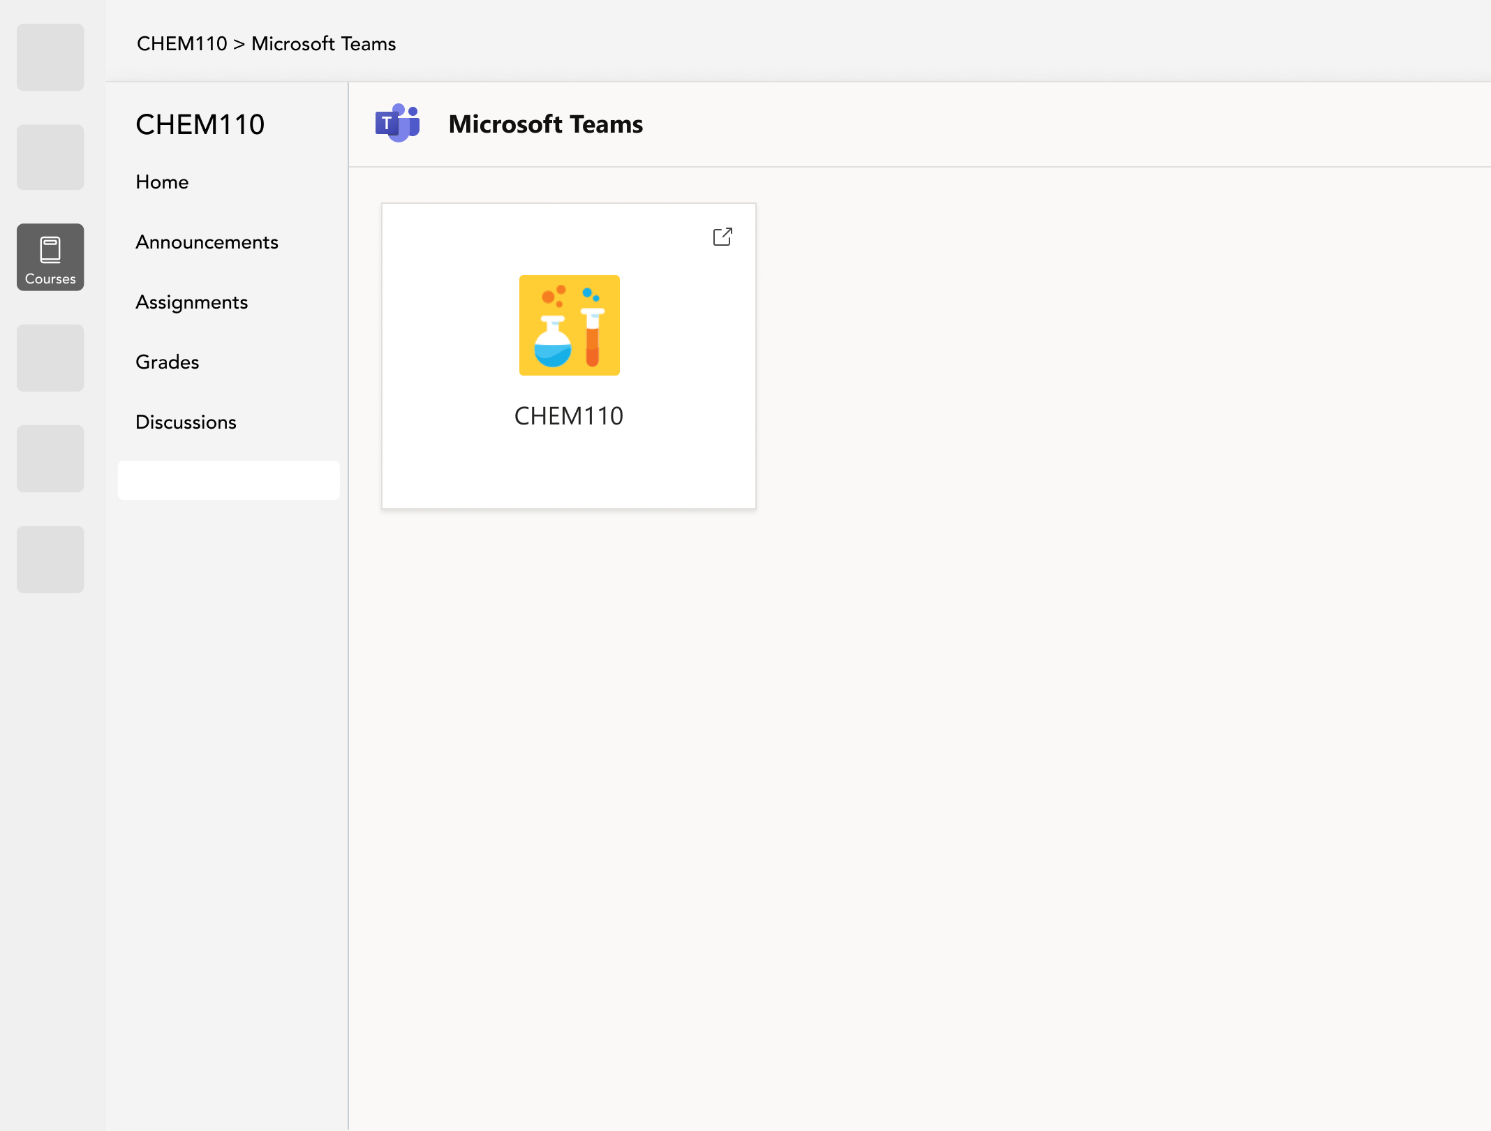
Create a Teams workspace for each course with the new Class Teams LTI app
With the new Class Teams LTI app, educators and students will be able to more easily navigate seamlessly between Teams and their course in the LMS.
Allow an educator to create a Class Team with the proper user roles within an LMS course based on the enrollment roster of the course in the LMS
Respect Teams admin & LMS privacy policies during Class Team creation
After creating the Class Team, educators and students can access the Team from within the LMS course or Teams
Support across desktop, mobile and web platforms
Release timing: July/August 2021 (Canvas/Blackboard)
Microsoft Confidential

Slide 8
LMS Integrations click through and sign-up
M365 LMS integrations sign-up form (microsoft.com)
Microsoft Class Teams LTI App (octe.azurewebsites.net)
M365 LTI Teams Meetings (octe.azurewebsites.net)
M365 LTI Apps and Canvas - OneDrive (octe.azurewebsites.net)
Canvas App - Immersive Reader (octe.azurewebsites.net)

Slide 9
SDS click through and links
Microsoft School Data Sync
Overview of School Data Sync - School Data Sync | Microsoft Docs
School Data Sync (SDS) (interactiveguides-schooldatasync.azurewebsites.net)
Microsoft FastTrack, move to the cloud with confidence

